Slide 1
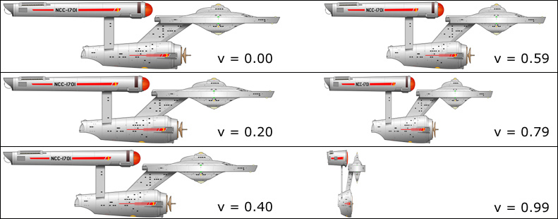
Special Relativity Calculations 2 The long and the short of it.

Slide 2

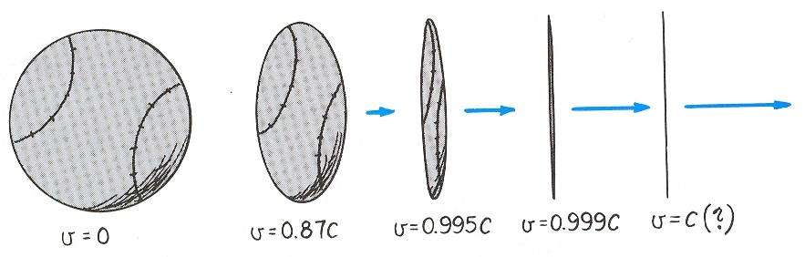
Special Relativity Review
Time Dilation Review
Length Contraction

Slide 3
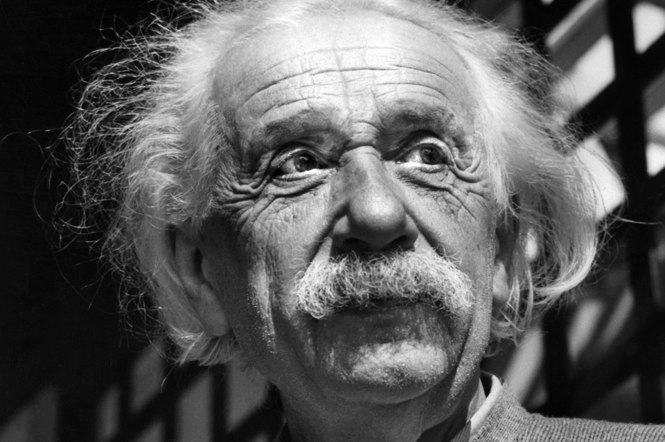
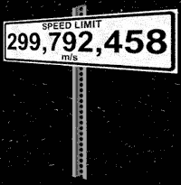
Two Postulates of Special Relativity
Einstein’s Special Theory of Relativity, published in 1905, was based on two postulates:
I. The laws of physics are the same for all frames of reference moving at a constant velocity with respect to each other.
II. The velocity of light in a vacuum c is constant for all observers, independent of their state of motion. (c = 3.00 x 10⁸ ms⁻¹)

Slide 4
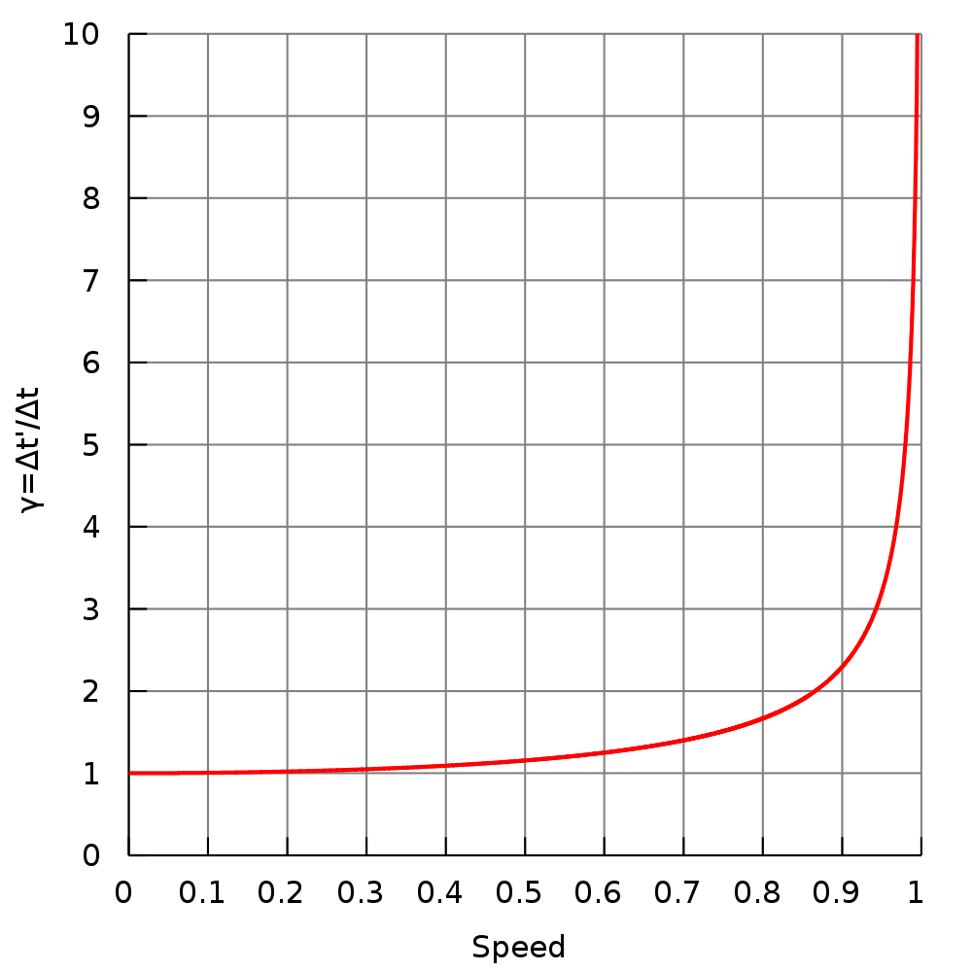
Time Dilation Review
Time measured for an event in a moving frame will be greater than the actual time for the event inside that frame, if measured from a reference outside the moving frame of reference.
In other words, time appears to go slower inside a moving frame when viewed from outside that frame.

Slide 5
Length and Distance Contraction
One of the other effects of relativistic speeds is that lengths are shorter when measured from a different inertial reference frame.
We call this length contraction.
It is important to note that because all motion is relative we can also apply the same observation when seen from the opposite frame of reference.
Lengths may also be replaced by distances, where the distance is seen from a moving object. The distance is actually a length measure on a frame with a different relative velocity.
E.g. If a ship if flying through space at 0.9c towards some distant star, space is moving relative to the ship, and thus the distance ahead contracts similar to a length and as such it too is shorter from the perspective of those on the ship.

Slide 6
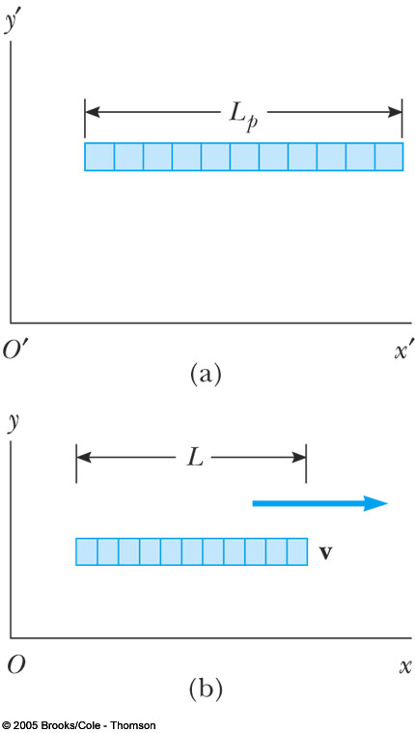
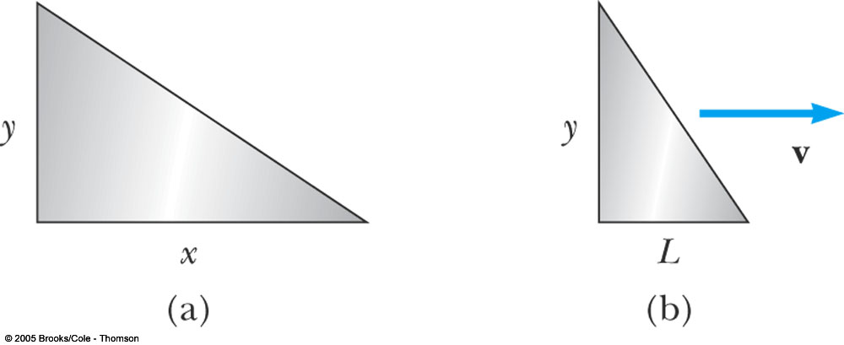
Length and Distance Contraction
It is important to note that these difference only effect measurements made in the same direction as motion.
There is no contraction on axes that are perpendicular to motion.

Slide 7
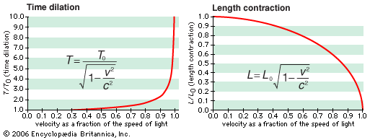

Slide 8
Spaceship Moving at the 10 % the Speed of Light
Spaceship Moving at the 99 % the Speed of Light
Spaceship Moving at the 86.5 % the Speed of Light
Spaceship Moving at the 99.99 % the Speed of Light

Slide 9
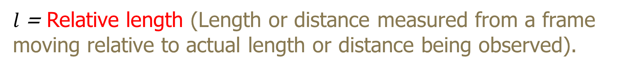
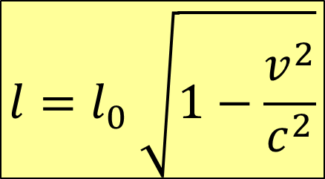
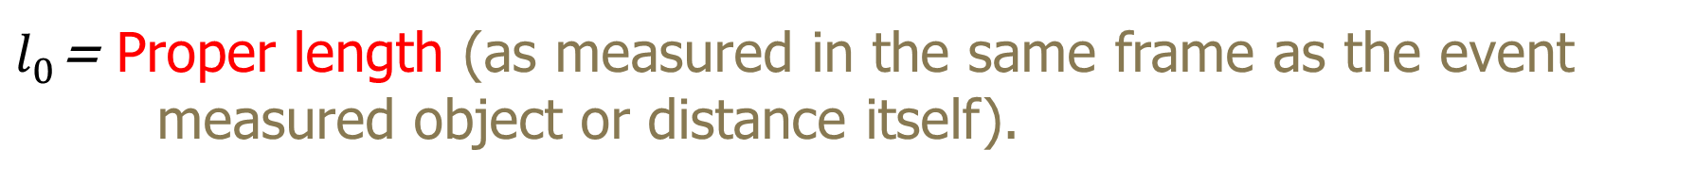
Length Contraction Equation
$$l=l_{0} \sqrt{1−\frac{v^{2}}{c^{2}}}$$
$l$= Relative length (Length or distance measured from a frame moving relative to actual length or distance being observed).
$l_{0}$= Proper length (as measured in the same frame as the event measured object or distance itself).
v = Relative velocity of two frames.
c = Free space velocity of light (c = 3 x 10⁸ m/s).

Slide 10
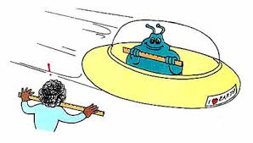

Length Contraction Example 1
$$l=l_{0} \sqrt{1−\frac{v^{2}}{c^{2}}}$$
Jeltz is a Vogon who has been observing Earthlings whilst gathering data required for planning the Earths destruction to facilitate an intergalactic highway construction project.
To reduce the chance of detection, Jeltz has been whizzing around the planet at 0.600 c in his 3.60m saucer. During one fly-past, he notices a human known as Arthur Dent who is holding a 50cm ruler. Jeltz uses his own ruler to measure the length of Arthur’s ruler. What length does it appear to him?
If Arthur sees the saucer, how long will the saucer appear to be?

Slide 11
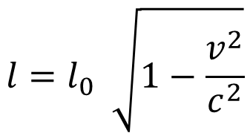



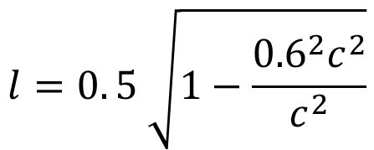

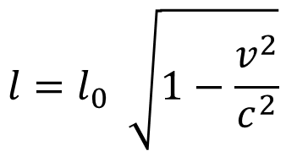
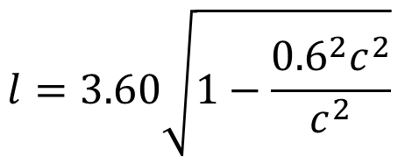
Length Contraction Example 1
Ruler
Saucer
$$l=l_{0} \sqrt{1−\frac{v^{2}}{c^{2}}}$$
$$l=l_{0} \sqrt{1−\frac{v^{2}}{c^{2}}}$$
$$l=0. 5 \sqrt{1−\frac{{0.6}^{2}c^{2}}{c^{2}}}$$
$$l=3.60\sqrt{1−\frac{{0.6}^{2}c^{2}}{c^{2}}}$$
$$l=0.5 \sqrt{1−{0.6}^{2}}$$
$$l=3.60 \sqrt{1−{0.6}^{2}}$$
$$l=0.40 m$$
$$l=2.88 m$$

Slide 12
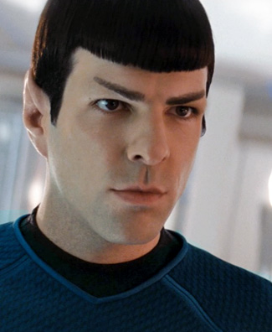
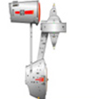
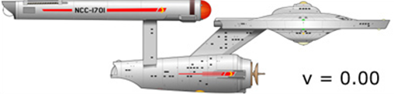

Length Contraction Example 2
Mr Spock stands on the observation deck of Deep Space Station K7, watching as the Starship enterprise zooms past at 0.99 times the speed of light.
Spock estimates the length of Enterprise as being 90.6m from his frame of reference. How long is the Starship as measured at rest?

Slide 13

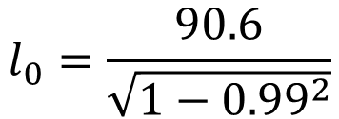

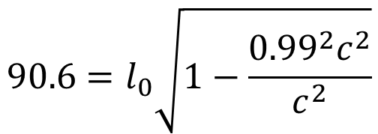



Length Contraction Example 2
$$l=90.6m$$
Actual Length
$l_{0}=$?
$$l=l_{0} \sqrt{1−\frac{v^{2}}{c^{2}}}$$
$$v=3.00x{10}^{8}ms^{−1}$$
$$90.6=l_{0}\sqrt{1−\frac{{0.99}^{2}c^{2}}{c^{2}}}$$
$$l_{0}=\frac{90.6}{\sqrt{1−{0.99}^{2}}}$$
$$l_{0}=642 m$$

Slide 14

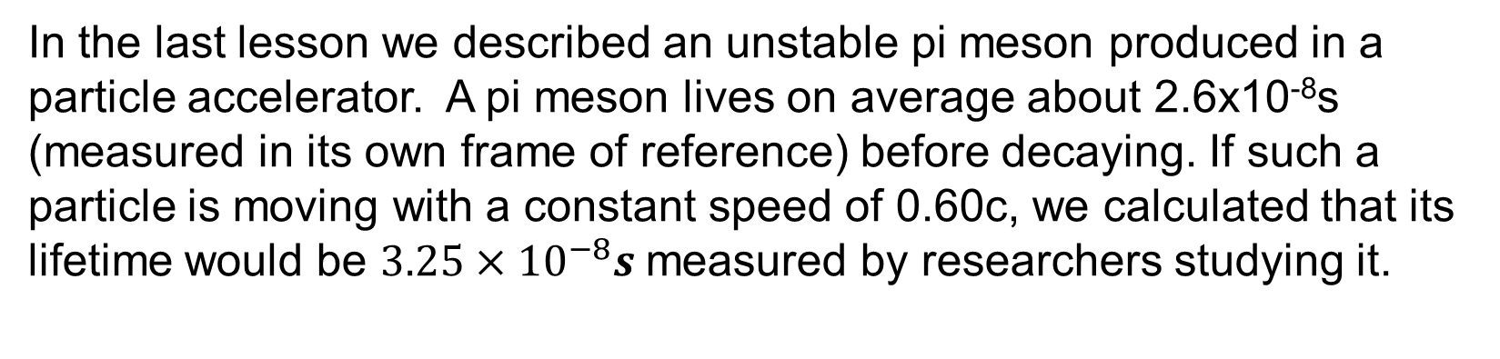

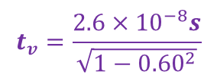
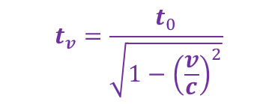
Time Dilation Example 3
$$t_{v}=\frac{t_{0}}{\sqrt{1−{\left(\frac{v}{c}\right)}^{2}}}$$
In the last lesson we described an unstable pi meson produced in a particle accelerator. A pi meson lives on average about 2.6x10⁻⁸s (measured in its own frame of reference) before decaying. If such a particle is moving with a constant speed of 0.60c, we calculated that its lifetime would be $3.25×{10}^{−8}s$measured by researchers studying it.
$$t_{v}=\frac{2.6×{10}^{−8}s}{\sqrt{1−{0.60}^{2}}}$$
$$t_{v}=3.25×{10}^{−8}s$$
Using velocity and time taken for decay (as interpreted within each frame of reference) determine:
What distance, measured in the laboratory, does the particle move before decaying?
What distance, measured by an observer travelling with the meson, does the particle move before decaying?
Check the values you have obtained to see if they agree with the length contraction equation.

Slide 15







Time Dilation Example 3
$$t_{v}=3.25×{10}^{−8}s$$
$$t_{0}=2.60×{10}^{−8}s$$
What distance, measured in the laboratory, does the particle move before decaying?
What distance, measured by an observer travelling with the meson, does the particle move before decaying?
$$v=\frac{s}{t}$$
$$s=v×t$$
$$s=1.8×{10}^{8}m⋅s^{−1}×3.25×{10}^{−8}s$$
$$s=5.85m$$
$$v=\frac{s}{t}$$
$s=v×$ t
$$s=1.8×{10}^{8}m⋅s^{−1}×2.60×{10}^{−8}s$$
$$s=4.68m$$

Slide 16



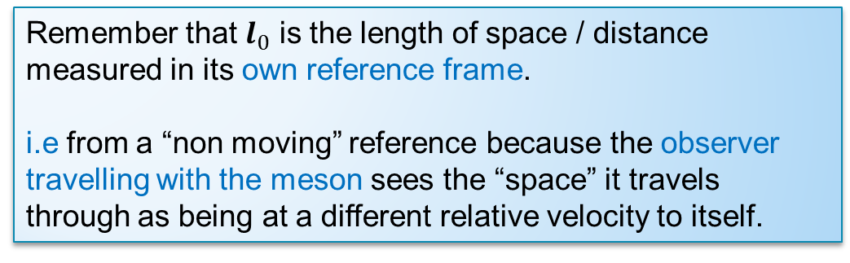



Time Dilation Example 3
$$t_{v}=3.25×{10}^{−8}s$$
$$t_{0}=2.60×{10}^{−8}s$$
Check the values you have obtained to see if they agree with the length contraction equation.
$$l=l_{0} \sqrt{1−\frac{v^{2}}{c^{2}}}$$
$$l=4.68m$$
$$l_{0}=5.85m$$
$$l=5.85\sqrt{1−\frac{{0.60}^{2}c^{2}}{c^{2}}}$$
Remember that $l_{0}$ is the length of space / distance measured in its own reference frame.
i.e from a “non moving” reference because the observer travelling with the meson sees the “space” it travels through as being at a different relative velocity to itself.
$$l=5.85\sqrt{1−{0.60}^{2}}$$
$$l=4.68 m$$

Slide 17
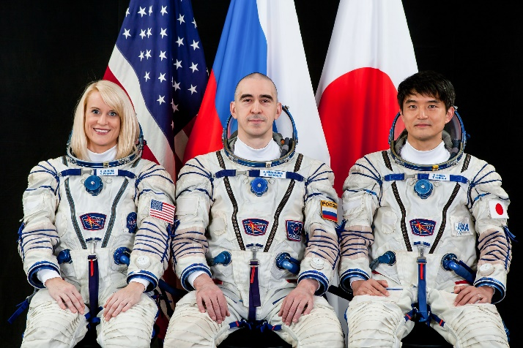
2016 Physics Sample Exam Question
A group of astronauts is sent on a mission to collect data about an exoplanet that could possibly sustain human life. The spacecraft travels at a constant speed of 0.850c. Two identical clocks that have been synchronised carefully on the Earth are to be used during the mission. One clock is left with an observer on Earth and the other is placed on the spacecraft. In the Earth’s frame of reference, the clocks are observed to tick once every second.

Slide 18
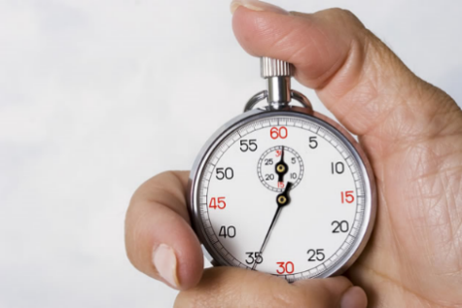
2016 Physics Sample Exam Question
How much time, in seconds, would pass between ticks of the clock on the moving spacecraft in the spacecraft’s reference frame?
According to the first postulate of Special relativity, the laws of physics for observers in the spaceship are the same as anywhere else, there is no difference between “normal” and what they experience. Thus ticks take exactly 1 second as they would if there were no motion. Observers outside the moving frame may disagree (an suggest the ticks take longer) but both are correct in their own reference frame.

Slide 19
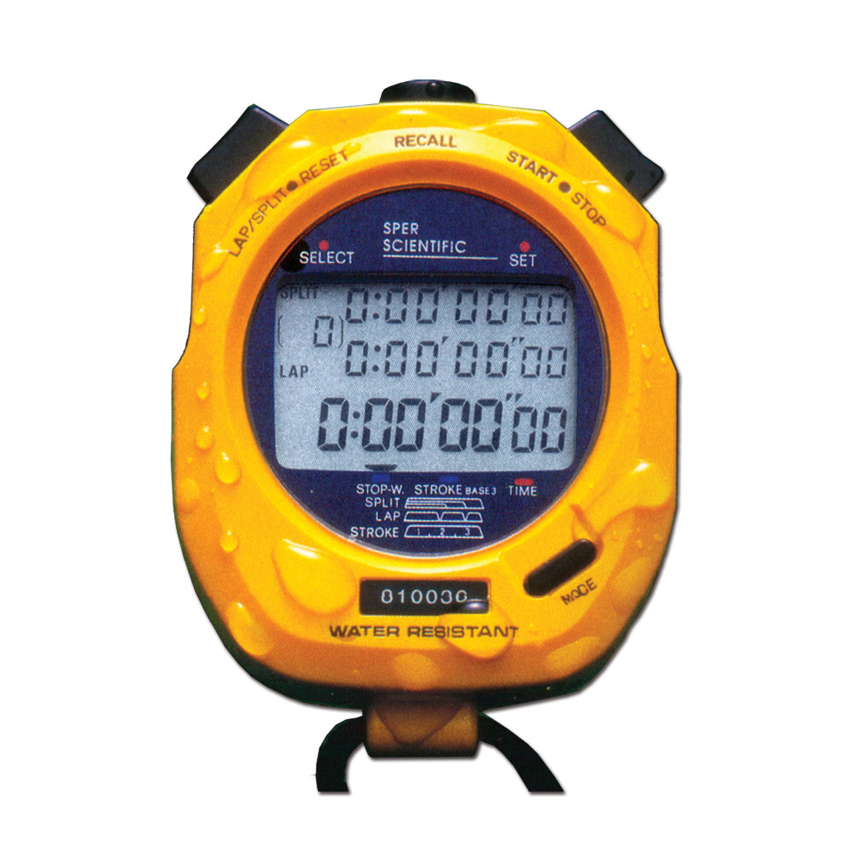



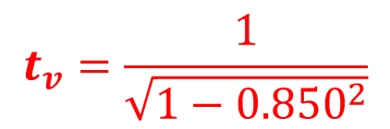
2016 Physics Sample Exam Question
How much time, in seconds, would appear to pass between ticks of the clock on the moving spacecraft according to an observer in the Earth’s frame of reference?
$$t_{v}=\frac{t_{0}}{\sqrt{1−{\left(\frac{v}{c}\right)}^{2}}}$$
$$t_{v}=\frac{1}{\sqrt{1−{0.850}^{2}}}$$
$$t_{v}=\frac{1}{\sqrt{1−{\left(\frac{0.850c}{c}\right)}^{2}}}$$
$$t_{v}=1.90 s$$

Slide 20

2016 Physics Sample Exam Question
Explain why the values in (a) and (b) are different. (3 marks)
The observer on the spaceship is not moving relative to the clock and as such is measuring proper time.
There is relative motion between the observer on Earth and the clock.
Einstein's theory of relativity says that time is slower for objects at relativistic velocities when viewed from an external reference frame.

Slide 21
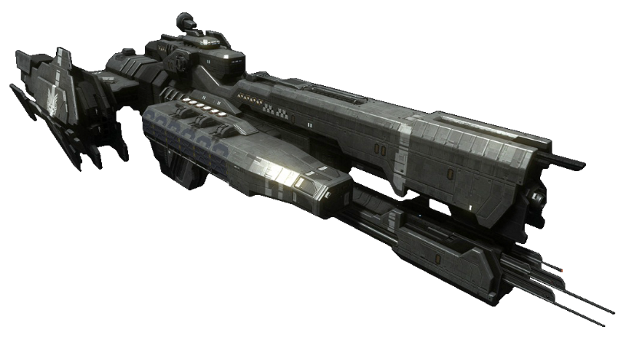
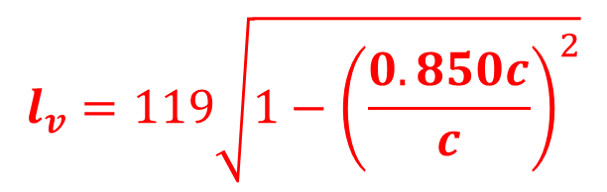



2016 Physics Sample Exam Question
When measured on the Earth, the spacecraft is 119 m in length. Calculate the length of the moving spacecraft, in metres, as measured by an observer in the Earth’s frame of reference. (2 marks)
$$l_{v}=119 \sqrt{1−{0.850}^{2}}$$
$$l=l_{0} \sqrt{1−\frac{v^{2}}{c^{2}}}$$
$$l_{v}=62.7 m$$
$$l_{v}=119\sqrt{1−{\left(\frac{0.850c}{c}\right)}^{2}}$$

Slide 22
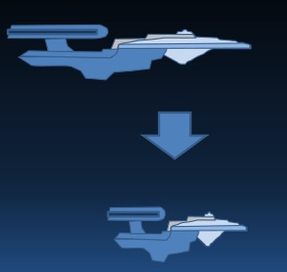
2016 Physics Sample Exam Question
Would the Earth observer notice any change in the height or width of the spacecraft? Explain your answer. (2 marks)
No change in height or width
Length contraction only occurs in the direction of motion.

